Slide 1
BIT 6113
Database Management System
Sushil Bhattarai
sushil.bhattarai@texascollege.edu.np
Lincoln University College, CN 1221

Slide 2

Normalization
• Main objective is to organize data in tables
Helps maintain relations between tables
One value should be at only one place
• Break down the data in smaller sizes
• See the following example of a table “Student” with following data
Here, the Instructor is stored in multiple places. If the name of one of the Instructors need to be changed, the data in multiple places needs to be changed.
If one of the students (say Shyam Prashad) decides to study a new subject, 2 columns (Subject and Instructor) need to be updated. The name of each of the subject and Instructor appears multiple times in the table.

Slide 3
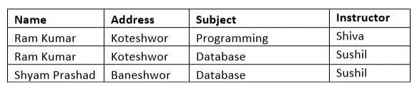
Normal Forms:
1 NF
2 NF
3 NF
1NF Rule
Each table cell should contain a single value
Each row must be unique.
The above table can be redesigned using 1NF as
Each cell now contains single value but still the data is repeated.

Slide 4
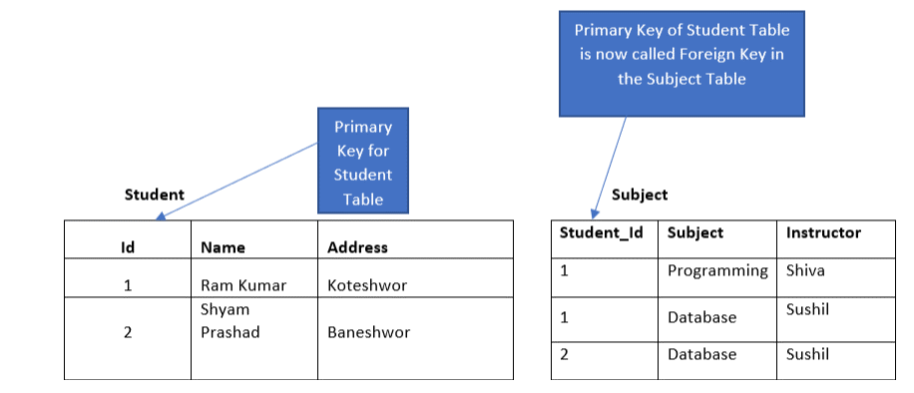
2NF rule
Table should be in 1NF
Single Column Primary Key
The table can now be redesigned into Student and Subject tables as
Notes:
In 2NF, Student Name determines the Subject and Subject determines the Instructor. So, Student Name determines the Instructor through subject(Instructor and Subject are Functionally Dependent on Student). So, columns Student and Instructor are Transitively Dependent. To avoid this dependency, a fourth table Detail is added.

Slide 5
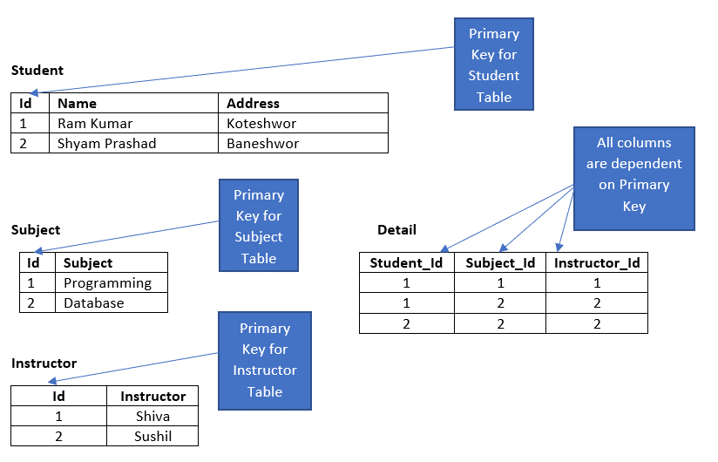
3NF rule
Table should be in 2NF
There should not be any transitive dependencies
In 2NF, Student Name determines the Subject and Subject determines the Instructor. So, Student Name determines the Instructor through subject(Instructor and Subject are Functionally Dependent on Student). So, columns Student and Instructor are Transitively Dependent. To avoid this dependency, a fourth table Detail is added.

Slide 6
Example of Normalization
Consider the following data of different projects that has to be stored in a table
Project
Employeename | Departmentname | Projectname | Time
Ram, Shyam, Hari | Finance | Assets, Mutual Fund, Profitability Analysis | 4.5, 3, 7
Krishna, Rabindra | R&D | MicroStrategy, Tableau | 8, 9
Break down the above data into appropriate tables using the 1,2 and 3 Normal Forms.
1NF
Project
Employeename | Departmentname | Projectname | Time
Ram | Finance | Assets | 4.5
Shyam | Finance | Mutual Fund | 3
Hari | Finance | Profitability Analysis | 7
Krishna | R&D | MicroStrategy | 8
Rabindra | R&D | Tableau | 9

Slide 7
2NF
Employee
ID | Employeename | Departmentname
1 | Ram | Finance
2 | Shyam | Finance
3 | Hari | Finance
4 | Krishna | R&D
5 | Rabindra | R&D
Project
ID | Projectname
1 | Assets
2 | Mutual Fund
3 | Profitability Analysis
4 | MicroStrategy
5 | Tableau
Details
EmployeeID | ProjectID | Time
1 | 1 | 4.5
2 | 2 | 3
3 | 3 | 7
4 | 4 | 8
5 | 5 | 9

Slide 8
3NF
Employee
ID | Employeename | DepartmentID
1 | Ram | 1
2 | Shyam | 1
3 | Hari | 1
4 | Krishna | 2
5 | Rabindra | 2
Department
DepartmentID | Departmentname
1 | Finance
2 | R&D
Details
EmployeeID | ProjectID | Time
1 | 1 | 4.5
2 | 2 | 3
3 | 3 | 7
4 | 4 | 8
5 | 5 | 9
Project
ID | Projectname
1 | Assets
2 | Mutual Fund
3 | Profitability Analysis
4 | MicroStrategy
5 | Tableau

Slide 9
Assignment of Normalization
Consider the following data that has to be stored in a table
Break down the above data into tables using 1NF, 2NF and 3NF.
Name | Salary | Department | Department_head | Department_Location
ram, shyam, hari,krishna | 8000, 1000, 9000,8000 | IT | Krishna | Pokhara
kripa, sujan | 8000, 9000 | HR | sujan | kathmandu
The above data can be represented in 1NF as
Details
Name | Salary | DepartName | DepartmentHead | DepartmentLocation
Ram | 8000 | IT | Krishna | Pokhara
Shyam | 10000 | IT | Krishna | Pokhara
Hari | 9000 | IT | Sujan | Kathmandu
Kripa | 8000 | HR | Sujan | Kathmandu
Krishna | 8000 | IT |  | Pokhara
Sujan | 9000 | HR |  | Kathmandu

Slide 10
The above data can be represented in 2NF as
Details
Name | Salary | DepartmentId
Ram | 8000 | 1
Shyam | 10000 | 1
Hari | 9000 | 2
Kripa | 8000 | 2
Krishna | 8000 | 1
Sujan | 9000 | 2
Department
ID | DepartName | DepartmentHead | DepartmentLocation
1 | IT | Krishna | Pokhara
2 | HR | Sujan | Kathmandu
The above data can be represented using 3NF as
Department
Id | Department
1 | IT
2 | HR
Details
Id | Name | Salary | DepartmentId
1 | Ram | 8000 | 1
2 | Shyam | 10000 | 1
3 | Hari | 9000 | 2
4 | Kripa | 8000 | 2
5 | Krishna | 8000 | 1
6 | Sujan | 9000 | 2
DepartmentDetails
Id | DepartmentId | DepartmentHeadID | location
1 | 1 | 5 | Pokhara
2 | 2 | 6 | Kathmandu

Slide 11
Assignment of Normalization
Consider the following data, related to the students and library that is stored in a table
(Student Details) |  |  |  |  | (Book Details) |  |  |  |  | (Borrow Details) |  | (Library Fee Details)
Student | DOB | Gender | Class | Score | Book | Pages | Score | Author | Type | TakenDate | BroughtDate | Amount | Date | Remarks
Ram Kumar | 1/1/1990 | Male | 12A | 0 | Hard Times | 293 | 25 | Charles Dickens | Science fiction
Hari Das | 6/1/1991 | Male | 12B | 0 | Editha | 155 | 80 | William Dean Howells | Art
Gita Nepal | 12/20/1990 | Female | 11A | 0 | Show Boat, Database |  | 25, 40 | Edna Ferber, Connolly | Art, Technology
Design appropriate tables to store the above data.

Slide 12
